Slide 1
Existentialism
Humans are the only known animal, that defines itself through the act of living. In other words, first a man or woman exists, then the individual spends a lifetime changing his or her essential nature. This is true knowledge

Slide 2
The question of Being
________________________________
This means you alone must take a stand on whether ________________
No one else can take over the task of working out your “Being”
______________________begin to question how authentic/true one can be to themselves and what happens when one is not and begins to hide behind their social roles in society

Slide 3
Existentialism centres on the idea that ______________________which was captured by philosopher Jean-Paul Sartre. (we will get back to him)
However, existentialism itself was conceived a century earlier by noted philosophers Soren Kierkegaard and Freidrich Nietzsche .

Slide 4
Summarizing existentialism is easy: ___________________________________________________________________________________________________.
But, as you know from the earlier activities, reducing existentialism to a single sentence is only the tip of the philosophical iceberg.

Slide 5
Existentialism: Life __________________________ ______________________________________________________________________________________

Slide 6
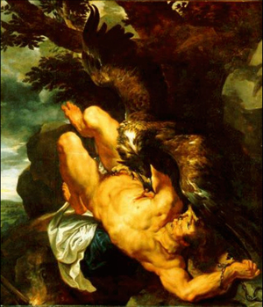
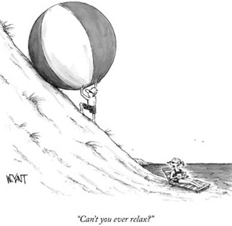
Existentialism is defined by two dominant images
Prometheus Bound: ______________________
Myth of Sisyphus : ______________________

Slide 7
Existentialism (or Me, Me, Me!)
Have you ever thought:
"How did I get into the world? Why was I not asked about it and why was I not informed of the rules and regulations, but just thrust into the ranks as if I had been bought by a peddling handler of human beings? How did I get involved in this big enterprise called actuality? Why should I be involved? Isn't it a matter of choice? And if I am compelled to be involved, where is the manager-I have something to say about this! Is there no manager? To whom shall I make my complaint?" (Young Man in Kierkegarrd's Repetition)

Slide 8
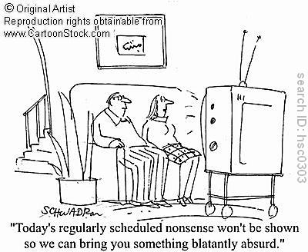
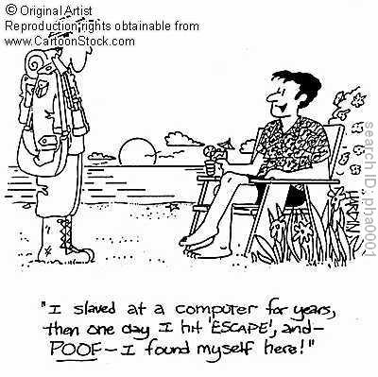
Kierkegaard: Two Main Existential Ideas
_____________
_____________

Slide 9
Nietzsche’s Main Ideas Regarding Existentialism

Slide 10
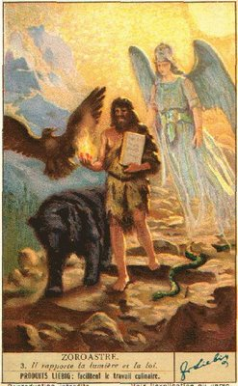
The Overman (Ubermensch): Loosely Translated as Superman--Man as a race is merely a bridge between animals and the overman. Nietzsche also makes a point that the overman is not an end result for a person, but more the journey toward self-mastery.

Slide 11
Will-to-Power
The will to power is the fundamental component of human nature. Everything we do is an expression of the will to power. The will to power is a psychological analysis of all human action and ___________________________________.

Slide 12
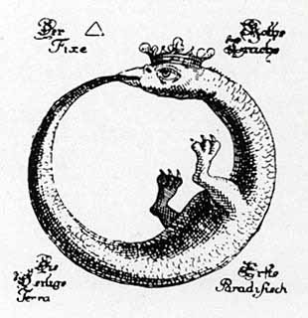
Eternal Recurrence
The eternal recurrence is the idea that ____________
__________________________________________________________________. Faced with the knowledge that he would repeat every action that he has taken, an overman would be elated as he has no regrets and loves life.
Ouroboros: Serpent that forever consumes itself

Slide 13
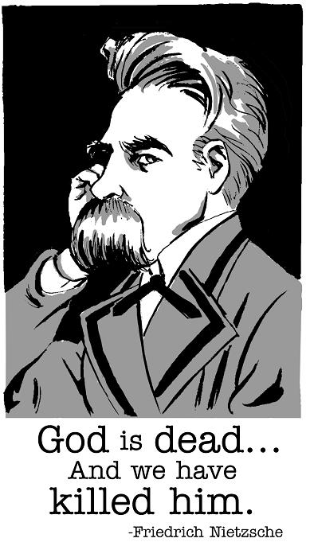
God is Dead: __________________________________________

Slide 14
Nihilism
After all of that if you are feeling adrift and questioning life's purpose, fear not! In fact, fear nothing as Nietzsche might suggest...
___________________________________________________________________________________________________.
A nihilist wouldn't argue that… __________________________________________________________________.

Slide 15
Some might argue that Shakespeare's Macbeth was a nihilist when he lamented "Life's but a walking shadow, a poor player that struts and frets his hour upon the stage and then is heard no more; it is a tale told by an idiot, full of sound and fury, signifying nothing."
And further evidence of nihilism in literature can be found in post-1860s Russian literature (Turgenev's Fathers and Sons Dostoevsky's Crime and Punishment) and the Hollywood movies, The Big Lebowski and Fight Club.

Slide 16
But don't lose all hope…
Even Nietzsche noted that "I praise, I do not reproach, [nihilism's] arrival. I believe it is one of the greatest crises, a moment of the deepest self-reflection of humanity. Whether man recovers from it, whether he becomes master of this crisis, is a question of his strength!"

Slide 17
The Verve – Bittersweet Symphony Lyric analysis - how does this song represent the point of view of a existentialist or nihilist? - highlight the lyrics and make direct connections to what we have discussed so far on ones state of “Being”.

Slide 18
Interactive activity called The Fugitive. It will test your understanding of Existentialism as it applies to an example from popular television from in recent history.
file:///C:/Users/Jilvan/Desktop/HZT%20Philosophy/HZT%20oerb/HZT4UPU01/HZT4UPU01A03/mme/2004_Existentialism.html

Slide 19
In director David Fincher's Fight Club, the film opens with a monotone narrative, as dreary as the life that Jack (the main character) lives.
Jack has been taught everything the world tells him is necessary to achieve popular notions of happiness.
He has a great job, an upscale apartment, sharp clothes, and an automobile.
Yet Jack is not happy.

Slide 20
In truth, deep down Jack is fading away and he is helpless to do anything about it. He cannot sleep properly, he doesn't eat, in fact Jack is just an empty shell going through the motions of life. His entire life he has been told by mainstream society what he needs to be happy. Why should he continue to accept these beliefs when they are actually killing him.
Eventually Jack meets an interesting and twisted character named Tyler Durden, who helps Jack realize that everything is wrong with his life.

Slide 21
Through Tyler, Jack slowly develops Jack into a nihilist, until he rejects everything he has ever been taught about what is necessary to enjoy a successful and happy life.
Jack comes to reject pop culture (You are not your job. You are not the money in your bank account. You are not the car you drive. You are not how much money is in your wallet. You are not your clothes).
Jack comes to realize all of his possessions only make his life experience empty.

Slide 22
Jack now loathes his former 'happy' life. The numbness he once felt with life turns to anger and excitement, which is channelled within "Fight Club", a secret place where confused men meet to do battle as pit fighters.
Nihilism brings life to Jack and his band of characters within Fight Club. The obstacles that once plagued him are swept away; he achieves good sleep for the first time in years. Life does not become perfect for Jack, and there are many continuing trials, but by the film's end Jack sees new hope after living a nihilistic life.
Consider viewing this film to see how the concept of a nihilistic approach to everyday modern life, is highly feasible.

