Slide 1
UNDERSTANDING SOCIAL AND POLITICAL PHILOSOPHY

Slide 2
QUESTIONS:
Is it human power or divine power that gives a government authority?
By what right does a government retain control over the people?
Who should control the economy: government or market?
Should society ensure that wealth is distributed evenly? If so – how?
These are some of the questions we will explore, through the writings of political philosophers and activists.

Slide 3
When do citizens have a responsibility to obey the law, and when are they justified in protesting against their government?
Although disturbing, the practice of suicide as a means of protest forces us to consider the importance of rights and freedoms, and the lengths people will go to secure them.
How far would you go??

Slide 4
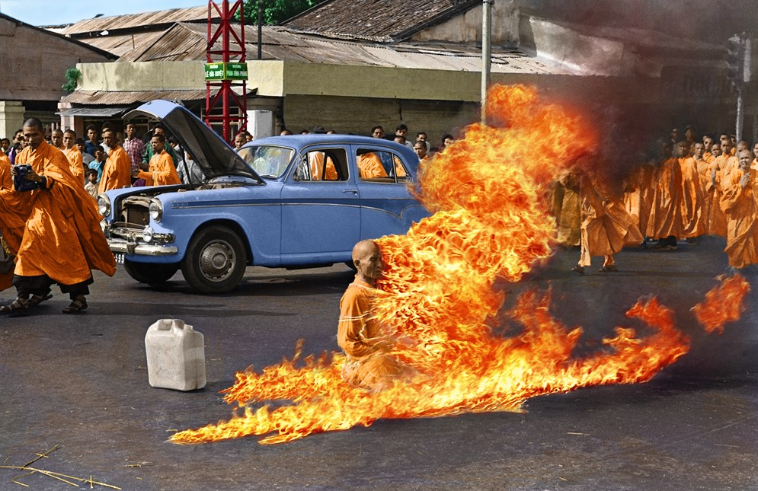
In 1963,73 year old Thich Quang Duc, a Vietnamese Buddhist monk sat down in a street in Saigon in the meditative position. He poured gasoline all over his body and set himself alight. t was the ultimate protest by Buddhists against political oppression they felt in Vietnam.

Slide 5
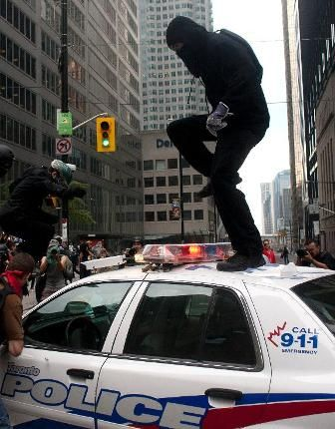
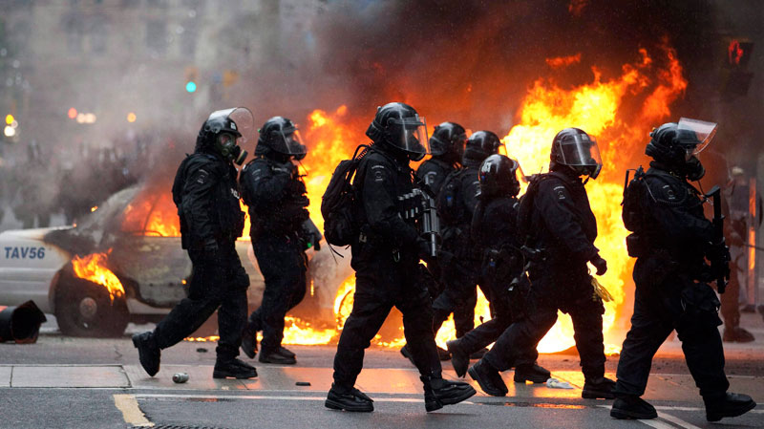
So how should a government respond to political protests??
A protest against the G-20 Summit in Toronto turns violent as masked demonstrators stamp on a police vehicle.
What are the limits to freedom of expression? How is this act different then the suicidal act?

