Slide 1
Eastern Philosophy: Introduction

Slide 2
When people become ill, they will often seek a second opinion. With so much at stake, this makes sense. So why not do the same for philosophy when you are looking to learn the answers to the Big Questions?

Slide 3
Unfortunately, in North America and Europe, Eastern philosophy rarely receives the same attention as Western philosophy.
However, Eastern philosophy has existed at least as long as Western, if not longer. Yet, as you will discover, the similarities and differences make the visit worthwhile.

Slide 4
The Four-Sided Coin
You've probably heard the expression: there are two sides to every coin. Well, for philosophy, it is more like 4 sides - the two on top and the two beneath. In many ways, Western and Eastern philosophy are quite different. Yet, as with the coin, they are united in form and substance.

Slide 5
To grasp Eastern philosophy you must first understand that it is quite different from Western philosophy in the following ways:
Religion is embedded and assumed within Eastern Philosophy.
The journey toward knowledge and wisdom is more valuable than the end result.
Knowledge comes over time.
Texts often show rather than tell.

Slide 6
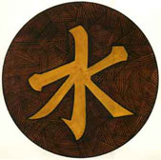
Eastern Perspectives
As with Western philosophy, Eastern philosophy has a series of different branches. However, as noted, these branches are spiritually centred. The main branches are:
Buddhism Taoism Confucianism Hinduism

Slide 7
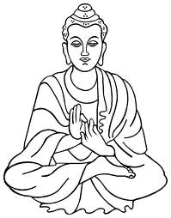
Buddhism
Buddha taught that reality was ever-changing and inter-related.
Through meditation, he determined that people suffer because they become addicted to change and fail to recognize what truly matters in life (enlightenment).
The seeker should strive for nirvana (the end of change and oneness with the universe).
This can be accomplished through both focussed meditation and karmic acts (performing good deeds).

Slide 8
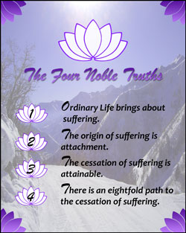
The Four noble Truths to Nirvana

Slide 9
Dukkha: Suffering is everywhere and a part of life.
Samudaya: There is a cause of suffering, which is attachment or misplaced desire (tanha) rooted in ignorance.
Nirodha: There is an end of suffering, which is nirvana (the possibility of liberation exists for everyone). One must cease all desires.
Marga: There is a path that leads out of suffering, known as the Noble Eightfold Path (right view, right thought, right speech, right conduct, right vocation, right effort, right attention and right meditation).

Slide 10
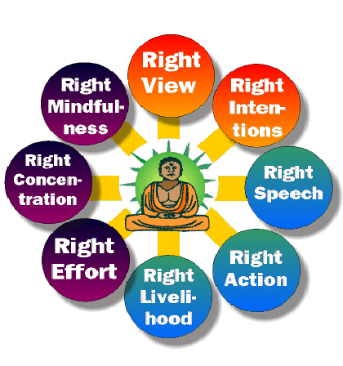
The Philosophy of the Eight Fold Path

Slide 11
Buddhist Commandments

Slide 12
Zen is Meditation to Achieve Non-Thought

Slide 13
Zen began with the Flower Sermon: “Pick up flower, subtle smile”
Lotus Flower

Slide 14
Chinese Philosophy
Some Concepts

Slide 15
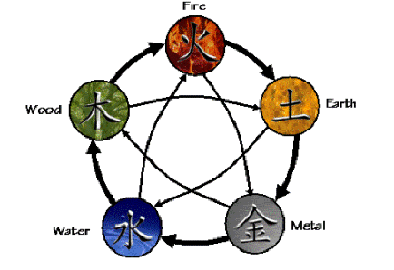
A Holistic Model: The Five Elements

Slide 16
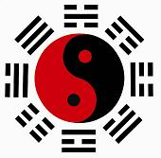
The I Ching – a compendium of divination based on Hexagrams
A hexagram is a figure composed of six stacked horizontal lines
Solid Line = Yang
Broken Line = Yin

Slide 17
Eight Trigrams: The Bases for all the 64 hexagrams The lower line represents the earth, the line in the middle represents the person and the higher line represents the heaven. When two trigrams are combined, the hexagrams are formed, creating the sixty-four combinations of the I Ching.
Heaven
Thunder
Water
Mountain Earth
Wind
Fire
Lake

Slide 18
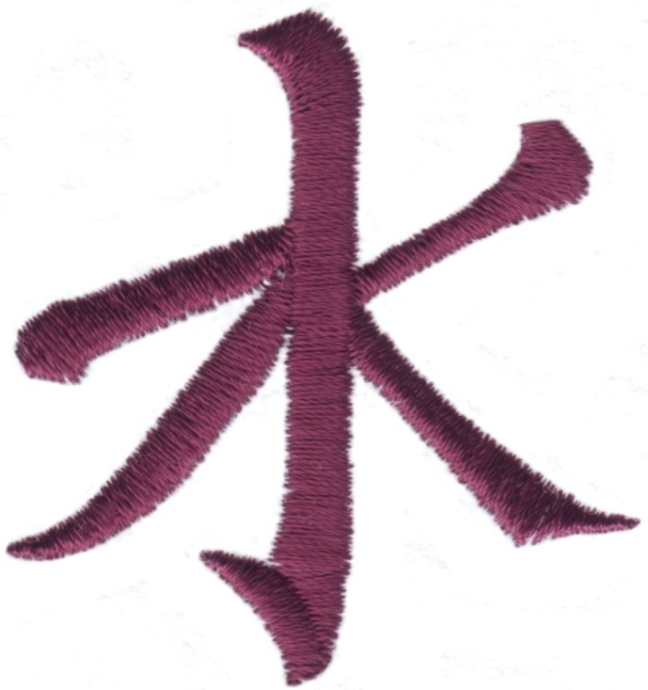
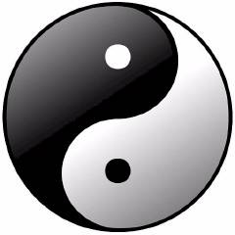
Two Main Trends in Chinese Philosophy
Taoism
Confucianism

Slide 19
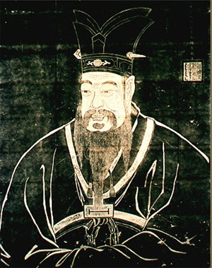
In Chinese culture, philosophy has replaced the state’s religion
The motto is:
Sageliness Within and Kingliness Without
Each person should be both a 'sage', achieving equilibrium and content by meditation, and a 'king' in the management of public affairs.
Confucius

Slide 20
Chinese philosophy is practical: Not concerned with metaphysics or epistemology. The best person is a combination of a saint, scholar, and leader.
Kindness
Goodness
Proper being and relationships
Etiquette
Propriety and ritual
rules
Righteousness
discernment
education

Slide 21
The Person: A comparison
A succinct description of the "perfect person" is one who combines the qualities of saint, scholar, and leader.
They were to: cultivate themselves morally; participate in the correct performance of ritual; show filial piety and loyalty where these are due; and cultivate humaneness.
The opposite of the perfect person is the "small person" or "petty person.“ Petty means petty in mind and heart, narrowly self-interested, greedy, superficial, and materialistic.

Slide 22
Confucianism
Developed, taught and practiced by Supreme Sage K'ung-fu-tsu (Confucius), Confucianism became the principle guiding philosophy throughout China.
Confucianism's purpose is to help seekers gain enlightenment through the revitalization of forgotten nobility and virtue. As such, Confucianism holds much respect for elders and ancestors.

Slide 23
Interestingly both Confucius and Plato wanted the same thing: an enlightened despot (ruler) who used philosophy to rule well.
Take a moment to conduct a thought experiment where our current politicians and leaders are replaced with philosophers. Would this make for a better or worse world? Why or why not? How would the world and society change? Or would it? Was Lord Acton correct when he surmised that "power corrupts and absolute power corrupts absolutely"?

Slide 24
Taoism
Taoism is the 'Way' (path) to unify one with the ultimate reality
Unlike Buddhism, Taoism is not as readily achievable
Lao-tzu himself wrote, "The Tao that can be named is not the eternal Tao". In other words, discovering Tao is a unique journey for each seeker who must know for themselves when it has been achieved.

Slide 25
Taoism is a naturalistic philosophy; the journey is not one of deeds and checkpoints but rather steady acceptance of the ultimate truths
This idea is called wu wei (without action) and is central to Taoism's beliefs

Slide 26
Hindu Philosophy

Slide 27
As one of the world's oldest religions, Hinduism is massive not only in terms of followers, but also its own scope.
Hinduism teaches that there is one Ultimate Reality (often, but not always, called Brahman) and the goal of each individual soul is to realize Truth.

Slide 28
Unlike most Western religions, Hinduism permits multiple paths to this realization, whether monist or dualist.
Despite having different sects, Hinduism's goal remains the same: self-realization through seeking awareness, understanding and connection with Ultimate Reality.

Slide 29
“tat tvam asi” – That You Are
Almost all Indian Philosophy seeks enlightenment through self-discovery

Slide 30
Characteristics of Indian Philosophy
1) Anti Empirical and deals only with ultimate reality
2) Polytheistic and Pantheistic
3) Philosophy and Action are combined in the practice of Yoga (the search for the true self)

Slide 31
Yoga: The Goal of Harmony
Self-Discipline
Proper Posture
Concentration of Body
Sense Awareness
Proper Breathing
Meditation

