Slide 1
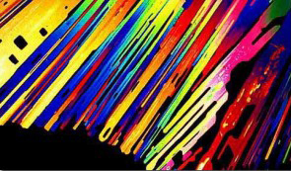
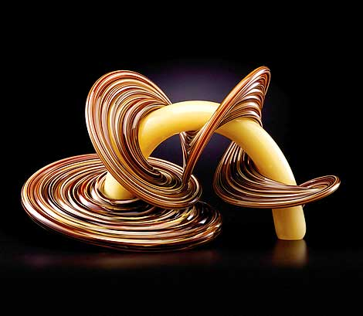
AESTHETICS

Slide 2
Aesthetics
While the current meaning of the term aesthetics and the study of it date from the 18th century, Aesthetics has its roots in Ancient Greece.
Originally, it referred to ideas of beauty. The current term most similar in meaning is esthetics, which is what beauticians study.
The study of the beautiful has now expanded to include theories of art, a term related to the skill or craft of making something.
Notes:
Possibly discuss product aesthetics and awards

Slide 3
Aesthetics - is a branch of philosophy dealing with the nature of beauty, art, and taste, and with the creation and appreciation of beauty.
It is more scientifically defined as the study of sensory or sensori-emotional values, sometimes called judgements of sentiment and taste.
More broadly, scholars in the field define aesthetics as "critical reflection on art, culture and nature.

Slide 4
Aesthetics takes us into considerations of what counts as art, beautiful or not and how art affects us on many levels: physically, emotionally, spiritually, and intellectually.
It asks the important question that we have already pondered, a question much debated among contemporary thinkers
- what is the definition of art?
Ancient and contemporary philosophers and art critics have attempted to define art, or to develop a criteria for determining what should be classified as art.

Slide 5
Human Body on Display: s it Art or is it Science?
Body Worlds

Slide 6
The Body World exhibit has appeared around the world in science museums, art galleries, and even zoos which shows the ambiguity surrounding the classification of these sculptures.
Aesthetics Questions:
Should it be considered art?
Have ethical boundaries been crossed by using real human bodies or does it serve a social, constructive purpose?
Does it honour or desecrate the human body?
Should there be limits on artistic expression of the human body as an aesthetic form?

Slide 7
So want is art? Some people may argue that art is anything you can get away with, but is this true? Can anything be art?
Definitions of art are diverse and endless. We understand and perhaps agree that art takes many forms yet we may have difficulty agreeing on one definition of art.
When we encounter art we know what we like and can probably explain why. However, do we have they ability to know when something should be considered a work of art? Are we well equipped to tell good art from bad?

Slide 8
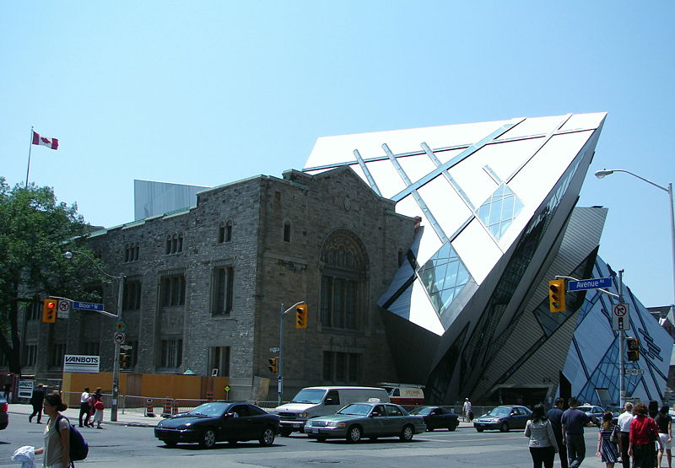
When you look at Libeskind Crystal at the ROM, do you see a building or a work of art? Do you like it – why or why not? This structure is a museum, thus functional. Can art be both functional and beautiful, or are its merits only on its beauty?

Slide 9
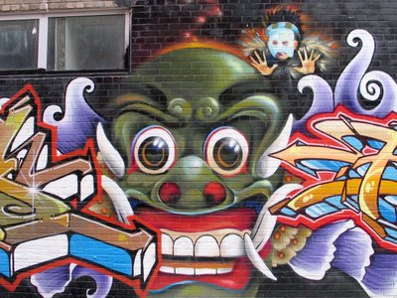
What about graffiti? The city of Toronto has launched the graffiti abatement program, an aggressive integrated enforcement plan to wipe out graffiti.
Is this art or vandalism? What is your reasoning?
If you do define graffiti as art, is tagging art? It is an artist’s stylized personal signature – can you justify your perspective?
Notes:
Abatement – to beat down cut away or put an end to

Slide 10
In small groups complete the following:
Develop your own definition of art, based on a list of criteria that determine what is considered art work.
As you develop your definition, consider what you deem to be art.
Provide some examples of works that you consider to be art and that you do not consider to be art, using your definition.

Slide 11
Lets now test/compare your criteria of art against the 10 most valuable paining in the world, using money as an indicator (which I know is contentious).
10 Most Expensive Paintings Sold

Slide 12
Defining Art
The definition of art has traditionally tended to focus on one or more of three aspects:
Representation
Expression
Form
Each of these aspects emphasizes different elements of what makes something a work of art

Slide 13
Defining Art cont…
Most works of art contain all three aspects, but determining which is most important for judging the merit of a work of art varies
While all three continue to be central to definitions of art, each was the dominant view at different times in the past.

Slide 14
1. Representation
Traced back to Plato, focuses on art as mimesis, a term usually translated as imitation or mimicry
In this definition, art should resemble reality. Plato believed that the reality we perceive is not the true reality, he believed that art was a copy of a false copy of true reality. (think back to the “ideal form”)

Slide 15
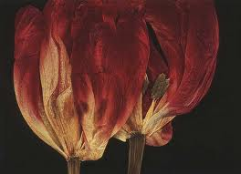
In fact, Plato was not a fan of art, seeing it as able to arouse false and dangerous ideas in those not educated to appreciate its true falseness.
In the ideal society he proposed in The Republic, he argued that art should be strictly controlled and censored by the Guardians.

Slide 16
This notion of art as imitated reality was the dominant idea until the end of the 18th century.
Most art was created with this in mind and superior works of art were considered to be those that most closely captured the truth of reality: art is not about itself, it is about the objective universe and the artist's skill in imitating it.

Slide 17
A superior work of art captures the essence of truth showing you a side of reality that you had not appreciated before. For example, a painting of a tree should look like a tree.
However, how one imitates reality is a challenge. For example, in telling a story, should it be narrated from the perspective of one of the participants or by an outside, objective narrator?
In addition, there is the question of which reality is being mimicked, to which was the problem that Plato alluded.

Slide 18
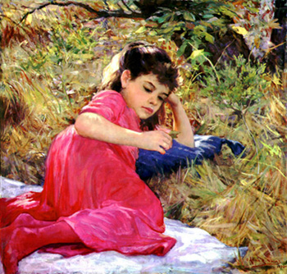

Slide 19
2. Expression
Expressionism traces back to Aristotle. It focuses on the ability of art to communicate meaning, particularly emotional meaning.
Aristotle saw art as providing catharsis, which allowed the audience to feel the emotions intended by the artist through the medium of the artwork.
In this definition, art is about the audience and its response to art - it is about how the art makes you feel. A superior work of art will cause a wide audience to learn an emotional truth, to feel the artist's expression.

Slide 21
This view of art was the dominant one during the 19th century and into the 20th. Art was seen as telling us something, either about ourselves or the human condition, primarily through its ability to affect our emotions.
In fact, the idea of self-expression came to dominate those who held this view of what was art, and art was often seen as something each of us should do for ourselves alone. Art was an experience.
For example, a painting of a tree does not need to look like a tree, but it should express the experience of being a tree.

Slide 22
In this view, the audience is the key element of an artwork. How they react, their thoughts and emotions roused by the art, rather than the intentions of the artist, was paramount.
The skill of the artist, and the value of the art, was measured by the ability to evoke experiences in the audience.
This idea was notably expressed by the American John Dewey in Art as Experience (1934), who argued that what made something art was its ability to create an aesthetic experience, a sense of beauty, in the audience. Without an audience, there could be no art.

Slide 23
One difficulty with this affective definition of art is that the artist's intended emotions may not be those felt by the audience.
If this is the case, has the artist failed? Or has the artist succeeded, albeit in an unintended way?
For example, many people may read the same novel but have greatly different experiences. They may not even agree on what the novel was really about.

Slide 24
If art is about the experience of the audience, and each person can be considered an entire audience, does this mean that the novel was about what each person felt it to be about, and within this view, what of the artist's intention?
Some argue that the intention of the artist is irrelevant to the work of art and all that matters is the audience response to it.
Finally, if art is defined only as something that affects you, nearly anything which causes an emotional reaction could be considered art.

Slide 26
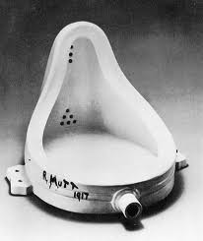
Is this art?

Slide 27
3. Formalism
This tradition traces its roots to the 18th century and in particular to Immanuel Kant. It is the intention of the artist to create a work that makes something art-art cannot be accidental.
The focus here is not on how well the work of art represents reality or moves the audience; it is on how well the work of art conforms to the goals and ideals of its form of art.

Slide 28
For example, a painting does not have to represent anything or communicate anything to the audience; it does not need to be about anything, so long as it demonstrates some aspect of the art of painting, such as technique or originality.
This view dominated much of the 20th century and stretched the definition of art to include many works that would not have been considered art previously, such as the abstract paintings of American Jackson Pollock or the surrealist works of Canadian Paul-Émile Borduas.

Slide 29
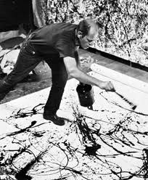
Jackson Pollock

Slide 30
Many of these types of works have no representational elements and were frequently difficult to understand, mostly because there was nothing to understand.
They were also criticized as lacking talent: Jackson Pollock essentially threw paint onto canvases.
The skill and craft of the artist has always been appreciated in superior art, but the emphasis here is on the work of art itself and on the skill of the artist in creating it.

Slide 31
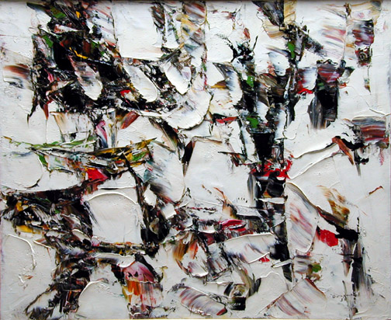
Paul-Émile Borduas

Slide 32
A major problem with this definition of art as technique is that the average person does not have a refined enough knowledge of artistic techniques to allow them to appreciate art based on this definition.
Clearly, to appreciate a good work of art requires some knowledge and sense of artistic refinement, but how much should be required? For formalists, the value of the art is the work, which can shut out the audience entirely and render art as something only for the artistically educated elite.

Slide 33
Another difficulty posed by this definition is what to do about art that does not fit within an existing form.
For example, if technology allows a new type of art to develop, how should it be judged, since it has no context for its form? As well, by what criteria should the form of a work of art be judged--are paintings only about the brushstrokes and the alignment of the objects on the canvas?

Slide 34
4. Recent Definitions of Art
Aside from the three traditional approaches to defining art, two other definitions for art emerged during the last half of the 20th century, the 'institutional' and 'historical tradition'.
Both of these definitions attempt to get around the difficulties posed by the focus on the three traditional aspects of the definition of art.

Slide 35
A. Institutional: the Artworld
The institutional definition emphasizes the notion of the art world as the source that decides what makes something art. The art world concept is defined in these terms:
An artist is a person who participates with understanding in the making of a work of art.
A work of art is an artifact of a kind created to be presented to an art world public

Slide 36
A public is a set of persons the members of which are prepared in some degree to understand an object which is presented to them.
The artworld is the totality of all artworld systems
An artworld system is a framework for the presentation of a work of art by an artist to an artworld public.

Slide 37
While this definition has the merit of simplicity, the art world will sort out what is and isn't art, it also has the problem of defining art world. Just how much understanding is required to become part of the art world? Can anyone appreciate art or does it require several university degrees?
Some advocates of this view use a broad definition, anyone who wants to appreciate art and who makes the effort can be part of the art world.
Others narrow it down, requiring a level of education and commitment to art appreciation beyond the ability of all but a few.

Slide 38
If the first definition of art world is correct, this means that everyone is part of it and anything anyone decides to declare art is art.
For example, you could decide your toenail clippings were art, if you decided you were prepared to understand them as such, even if most people would not agree with you. Perhaps you and your friends would form a public, who could appreciate the avant-garde (forward-looking) and exciting new art form of toenail clipping.

Slide 39
If the second definition is true, then your toenail clippings could still be considered art, but only if you could get an art expert to agree that they were.
You and your friends, unless certified in some way by the art world community just would not do, even if the vast public agreed with you.
This expert approach to determining what is and is not art has been derided for being elitist. Quite often, art experts like works that many in the public don't, and vice versa.

Slide 40
For example, Celine Dion is the most popular female singer in the world, her singing admired by hundreds of millions. But many music experts declare that her work is not a good example of the musical art. Who is right? Is Celine's work art?
This 'expert' approach to defining art really rests on the education of the experts.
As well, since what the art world designates as art has changed in the past - and will undoubtedly change in the future-the institutional approach to defining art does not really define what art is, simply who makes the decision.

Slide 41
B. Historicalist/Traditionalist
Related to the institutional approach is the historical approach, which defines art as something that follows a tradition of things which were (or are) considered works of art at some previous point in time.
This view focuses on the conventions of thought that cause us to declare something a work of art. It emphasizes the traditional definitions of art, and judges all new artwork in relation to the past.

Slide 42
As it is a version of the institutional definition of art, many of the same criticisms there apply here, particularly in relation to who decides what is included in an art history tradition.
Without a clear link to a tradition it would not be a work of art - new art is not possible. Our definition of art is stuck with what we have now.

Slide 43
As well, there are difficulties with art that is from outside the Western art history tradition - Hindu art, for example, may not fit into someone's view of what art should be.
In a more abstract vein, critics argue that a completely alien art tradition created by extraterrestrials would not be considered art using this definition, even if it met many of the criteria of other definitions.

Slide 44
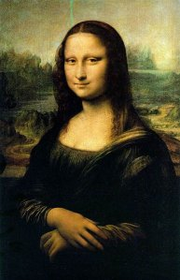
Review using Mona Lisa, by Leonardo da Vinci
This small painting, completed over many years in the early 1500's, now hangs behind a thick bullet proof glass in the Louvre Museum in Paris.
Its estimated value runs close to a billion dollars: it is the most valuable and most famous painting in the world.

Slide 45
There is controversy over what it actually represents, and some argue it is a self-portrait of da Vinci, rather than the portrait of Lisa del Giocondo, a wealthy young woman.
Her famous smile is enigmatic and has been the subject of much commentary and admiration for the affect it creates in viewers.
Da Vinci's artistic ability is notable, even stunning, in the painting's composition. Sure, people love it and everyone agrees that it is something special, but what makes it art?

Slide 46
A representationalist might focus on what the painting intended to show: a young woman, da Vinci, or the human condition.
An expressionist would consider how the audience has reacted to the painting: what emotions does it stir? How do people feel about it?
A formalist would look at the technique used: the symmetry, the way the hands are crossed, how the figure is turned just so.

Slide 47
The art world would consider how the educated react to the painting: how would the learned eye view the painting?
A 'historical traditionalist' would place it in the context of Western art, acknowledging that many consider this a work of art.

